Slide 1
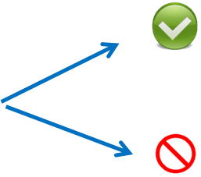
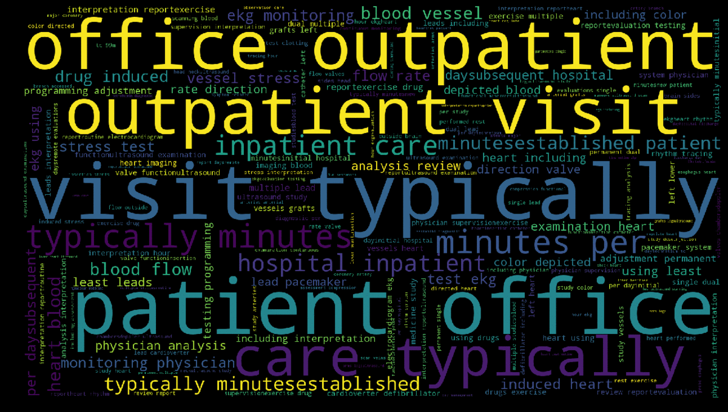
DocReach Predicting Physician Specialty from Text Data
Classifier
Cardiologist
(Data Confidential)
Sushil Sharma - Galvanize Cohort#65
Capstone Project – May’2018
linkedin.com/in/krishnatray
github.com/krishnatray

Slide 2
Business Problem - Summary
A social media marketing firm wants to target doctors / physicians based on their practice area.
Example: A marketing campaign to target Cardiologists for heart related news feed.

Slide 3



Business Problem
Marketing Campaign
e.g. News Feed, Adv.
Sarah
Marketing Manager
Cardiologists
Example: A marketing campaign to target Cardiologists for heart related news feed.

Slide 4
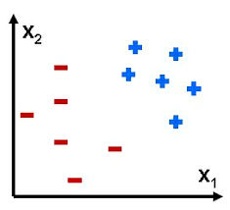

Project Scope
1
2
Predict cardiologists vs Non-Cardiologists
Multiclass classifier to predict top 5 specialties
Cardiologists
Internal Medicine
Cardiologists
Orthopedic
Family Practice
Diagnostic Radiology
Non-Cardiologists
Other

Slide 5
Data Source(s)
procedures.csv - contains a list of procedures doctors performed over the past year. The columns of this dataset are as follows:
physician_id unique physician identifier, joins to id in physicians.csv
procedure_code unique code representing a procedure
procedure description of the procedure performed (Text Column)
number_of_patients the number of patients the doctor performed that procedure on over the past year
physicians.csv - contains a list of doctors and their unique specialty. Specialty is listed as "Unknown" for the doctors need to be classified.
physician_id unique physician identifier, joins to id in physicians.csv
Specialty String e.g. Cardiologist
Text Column
Category Column

Slide 6


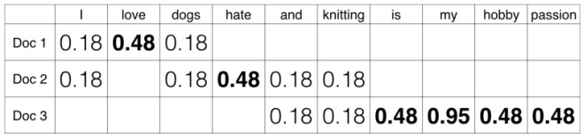
Text Processing
Text Data
Features
Classifier
Tokenization
Cleaning (Stop words, Stemming, etc.), N-Grams
Count Vector: TFIDF
Prep / EDA
Target Categories
Histograms
Load Data
Cleaning, Nulls
Cardiologist?

Slide 7
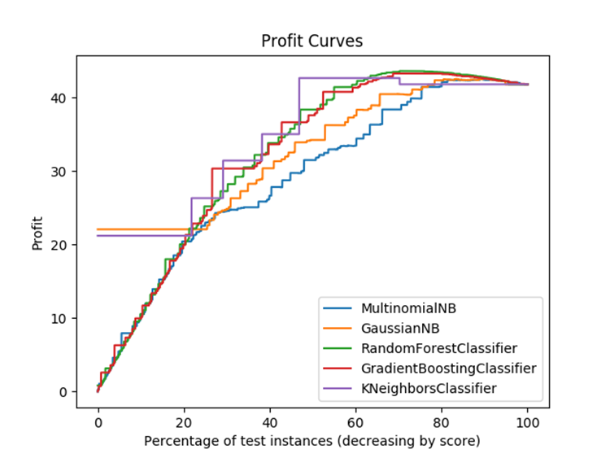
Results – Best Model (Binary)
Model Selection Method: Highest Profit
Best model: Random Forest
Resulting profit: $43.64
Accuracy: 80.5%
F1 Score : 0.81

Slide 8
Results: Multiclass
Model Selction Method : Highest F1 Score
Model | Accuracy | Precision | Recall | F1-Score
MultinomialNB | 66.5% | 0.67 | 0.67 | 0.66
GrBoosting | 69.8% | 0.67 | 0.70 | 0.66
RandomForest | 70.8% | 0.68 | 0.71 | 0.68
XGBoost | 68.8% | 0.65 | 0.69 | 0.65

Slide 9
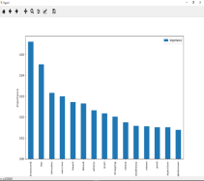
Top Features – Binary vs Multiclass
Top features – Binary Classifier
1 | heart
2 | interpretation
3 | study
4 | blood
5 | ekg
Top features – Multiclass Classifier
1 | ultrasound
2 | ray
3 | minutes
4 | vaccine
5 | heart

Slide 10
Next Steps / Future Plans
API / APP
Unsupervised Machine Learning
Custom Ensemble Models
Clustering, PCA, T-SNE
Model Performance
Find additional Features
Deep Learning
Explorer Deep Learning for Text Classification
Create Flask / Javascript Application /Api

Slide 11
Learnings / Challenges
Data Volume
Parameter to train on sample
AWS machine with multiple CPU
High Dimensionality
Training is Slow
Limited features to 1000
Gradient boosting is slow (Sequential)
XGBoost
No free lunch theorem
RandomForest outperfomed other algorithms (Binary classification)
SSH session timeouts / Process Monitoring
Tmux
htop

Slide 12

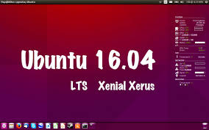
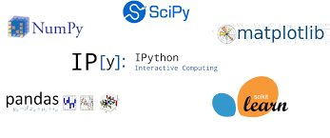


Technology Used

Slide 13
Thanks!
Sushil Sharma
Linkedin: https://www.linkedin.com/in/krishnatray
Github: https://www.github.com/krishnatray

Slide 14
Backup slides

Slide 15
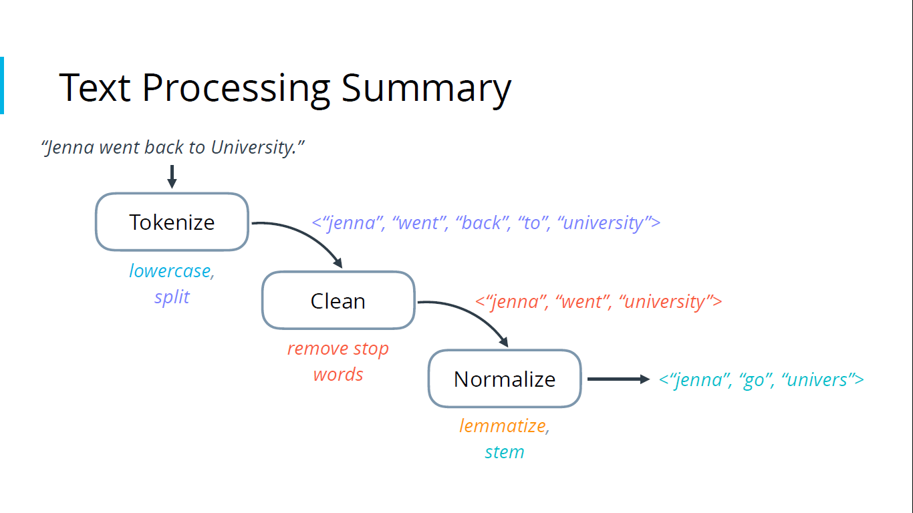

Slide 16
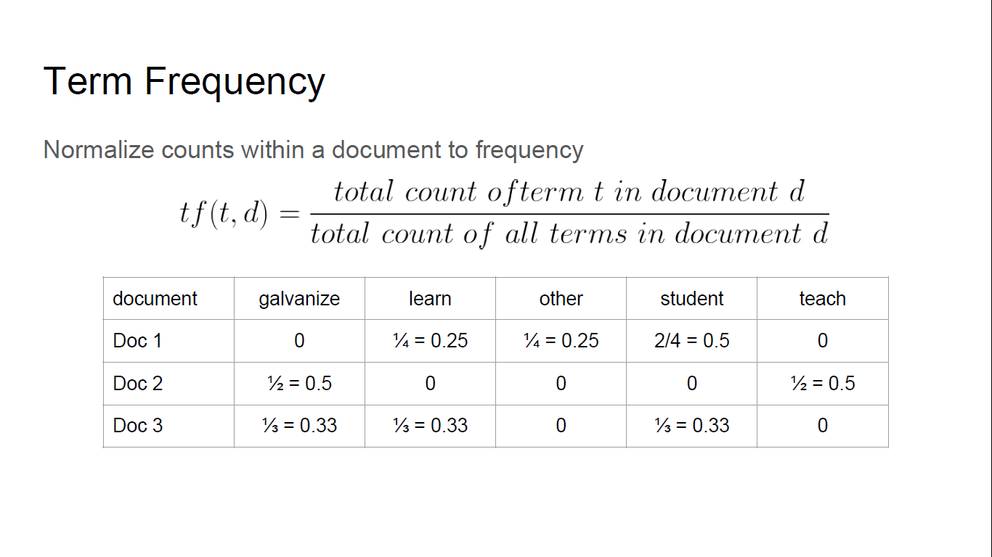

Slide 17
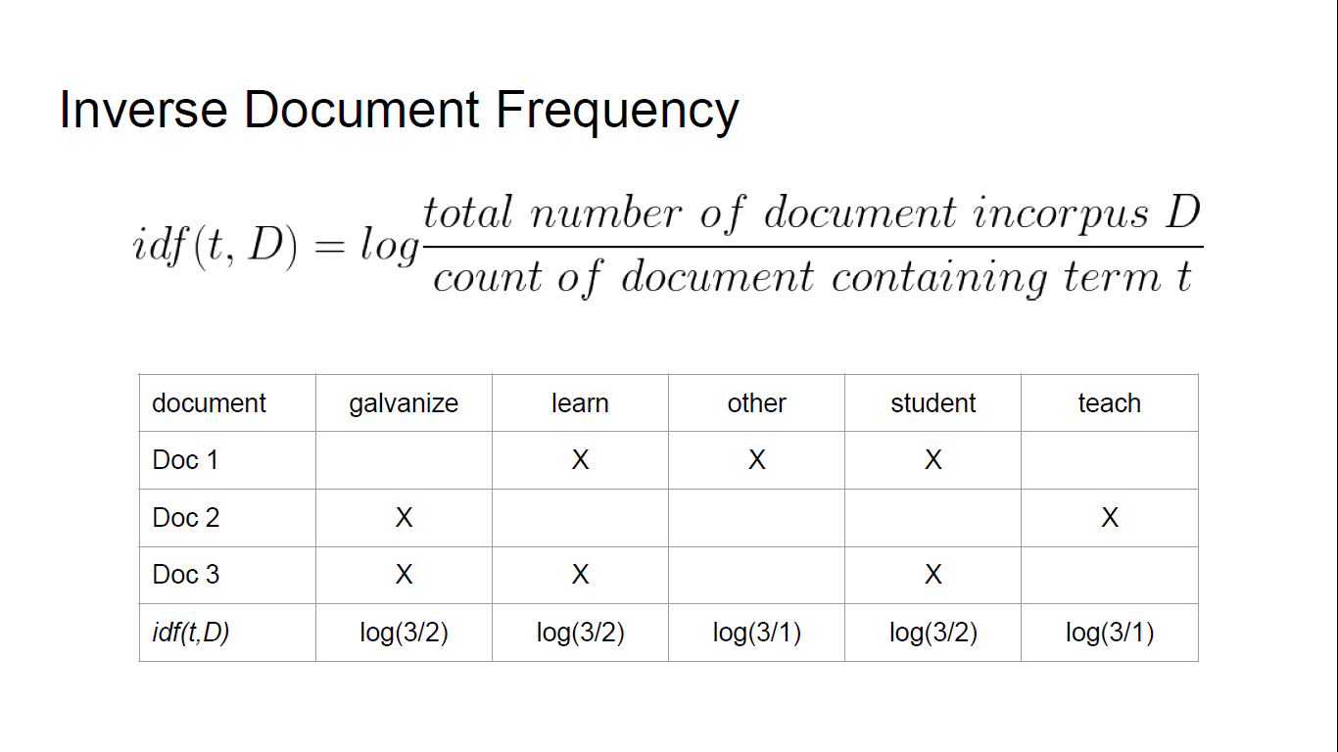

Slide 18
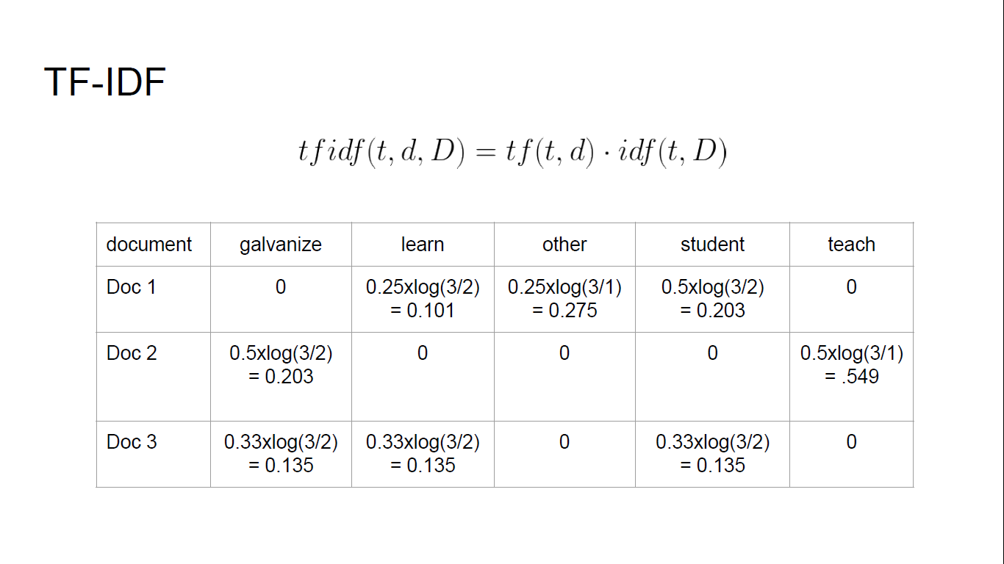

Slide 19
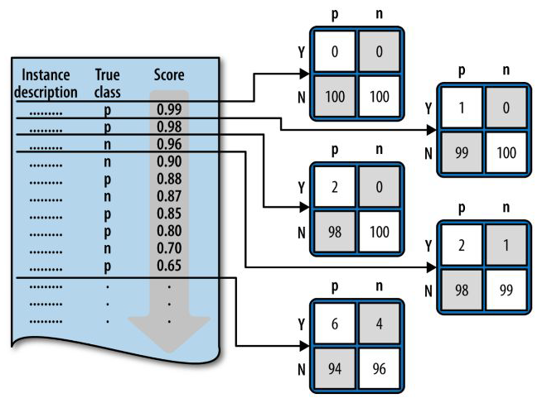
Cost Benefit
Predicted
 | 1 | 0
Actual 1 | TP $100 | FN = 0
0 | FP -$10 | TN = 0

Slide 21
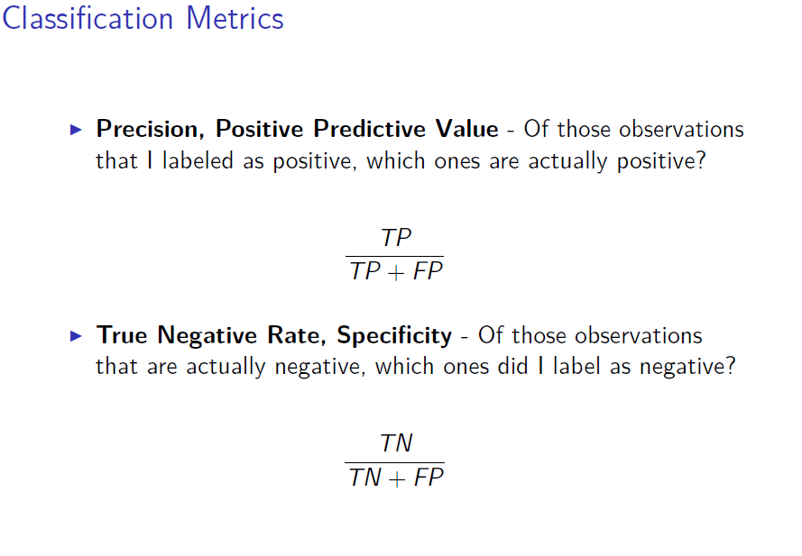
 | Predicted 1 | 0
Actual 1 | TP | FN
0 | FP | TN
Precision = P( Actual 1 | Predicted 1) = TP / (TP + FP)
Recall Or TPR = P( Prediction 1 | Actual 1) = TP / (TP + FN)

Slide 23
Data Summary
Total Instances: 406,690
Procedure length varies 6 – 256; Median 66
Binary Classes
Cardiologists 47%
Non-Cardiologist 53%
Multiclass picked top 5 and combined rest specialty as other
Cardiology 47%
Diagnostic Radiology 10%
Family Practice 7%
Internal Medicine 9%
Orthopedic Surgery 3%
Other 26%

Slide 24
Common words

Slide 25
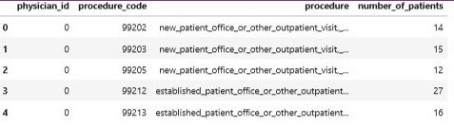
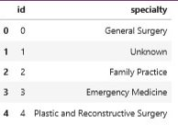
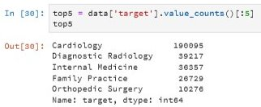
EDA

